Slide 1
ORL 5524 Session 11.0
Instrument Design and Valdation-
Content Validation and Cognitive Interviewing
Madhabi Chatterji, Ph.D.
Professor of Measurement, Evaluation and Education
Director, Assessment and Evaluation Research Initiative (AERI)
Teachers College, Columbia University

Slide 2
Agenda
Content validation of your own items and instruments in class
Lecture/Discussion
  Content Validation—Procedures and Methods
  Validating Response Processes with Cognitive Interviews—Procedures and Methods
  Examples
Readings posted last week: Polit et al,(2007); Lynn (1986); Carbone et al (2002)
Guest Speaker: Dr. Amanda Sarafian, CUMC Occupational Therapy Program, will share her research on instrument design and validation
Wrap-up
Mid-terms (by tomorrow!)

Slide 3
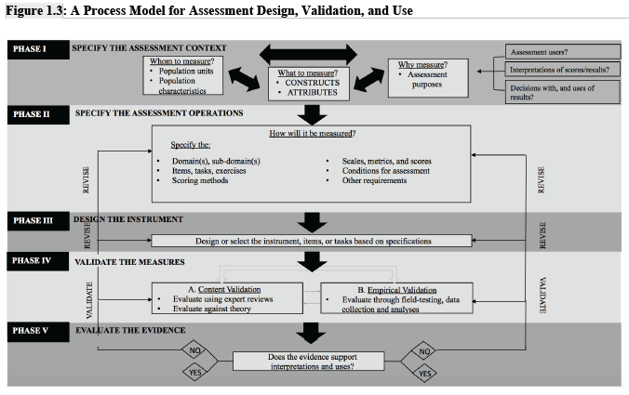

Slide 4
VALIDATION DATA COLLECTED IN EARLY DEVELOPMENTAL STAGES OF THE INSTRUMENT
  Three kinds of evidence are best collected during the early design phases—with a goal to modify and improve the items/ instrument before these are finalized
    Content Validity Evidence
    Evidence on the Validity of Response Processes
    Item Analysis –Statistical Properties (to identify malfunctioning levels of items via a small scale pilot study or field test)

Slide 5
I. Content Validation
Content validation—Procedures and Methods
  Timing? What to Review?
  Experts—who are “experts” and how many?
  Designing Content Validity (CV) surveys and the Content Validity Index (CVI)
    Computing and Interpreting CVI-Items (CVI-I) vs CVI for Scales (CVI-S)
    Correcting CVIs for chance—Setting tolerable errors using significance levels and Kappa coefficients
    Qualitative feedback and data: coding. synthesizing results

Slide 6
I. Content Validation- terminology
Content Based Validity = Content Validity (CV) in shorthand.
  Several labels but no change in essential meaning.
  “content validity” (see Crocker & Algina, 2006, p. 222),
  “evidence based on test content”, “content-oriented validity” (AERA, APA, & NCME, 1985; 1999, p. 11; 2014).
  NOT the same as Face Validity (FV).
  FV is the appearance of validity in the eyes of lay persons and test takers, gathered to raise acceptability of an assessment or instrument (Guilford, 1954; Mosier, 1947; Waltz & Bausell, 1981, not listed in Standards since 1970s).

Slide 7
I. Content Validation –Timing and CV-Qs
Timing: Do it early! As soon a drafted item pool or instrument are ready
What should be reviewed?
  Typical CV questions:
  Degree of match of individual items with targeted domain indicators ?
  Content relevance, link to the construct theory?
  Consistency of items with established item-writing guidelines?
  Clarity (lack of ambiguity) of item wording, format, graphics, or directions?
  (Lack of) the appearance of item biases—language, culture, gender?
  Appropriateness of response scales or scoring systems?
  overall content representation or coverage (e.g., against Table of Test Design Specifications)
  (See checklists in Chapters 6-9, Chatterji, 2003).

Slide 8
I. Content Validation- Experts and Ns
Content validation—Procedures and Methods
  Experts—who are “experts” and how many?
  It is best to define the qualifications of “expert” judges beforehand
  Consultation with professionals/peers
  Can vary in number from 2-12 (max) (Lynn, 1986; Polit et al 2007). Typically, 3-6.
  NOTE: CV results rely heavily on expertise, and criteria for selecting judges matter. Unqualified raters, lack of adequate content validation guidance or poor directions lead to unusable or poor quality of CV data.

Slide 9
I. Content Validation--Procedures
Content validation—Methods
  Designing Content Validity (CV) surveys
  Content Validity Index (CVI)
    Calculating and Interpreting CVI-Items vs CVI for Scales
  Correcting CVIs for chance—Setting tolerable errors using significance levels and Kappa coefficients
  Qualitative feedback and data: coding. synthesizing and acting

Slide 10
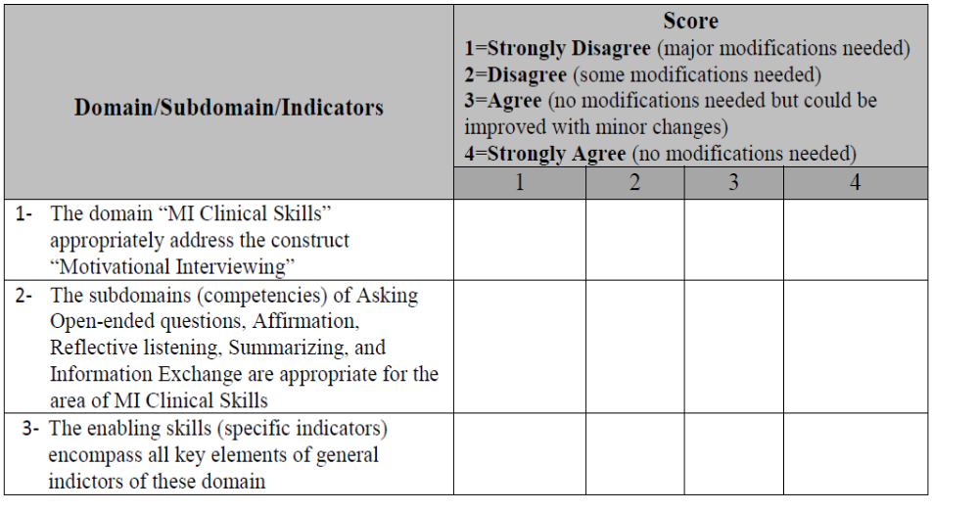
I. Content Validation Survey-Examples (Hosam Alrqiq, 2017)

Slide 11
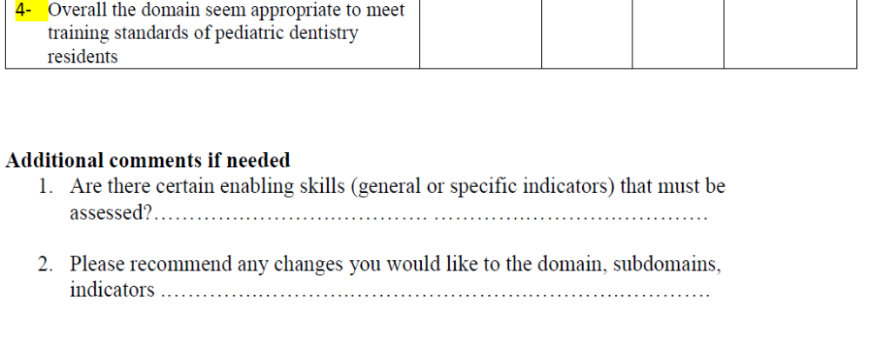
I. Content Validation Survey-Examples (Hosam Alrqiq, 2017)

Slide 12
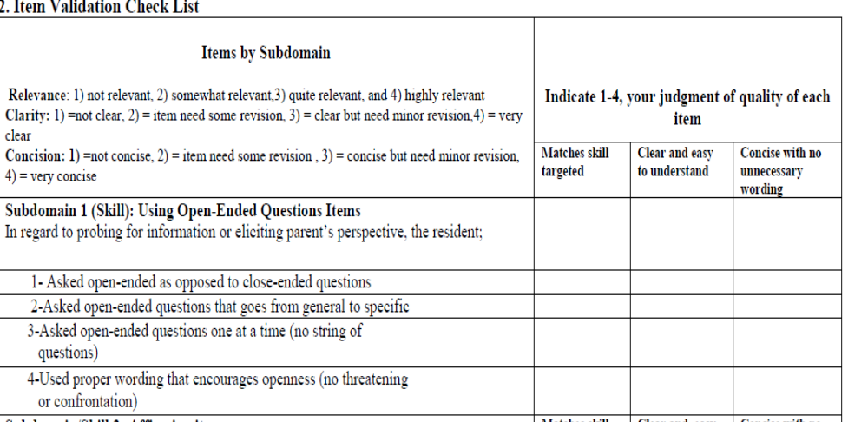
I. Content Validation Survey-Examples (Hosam Alrqiq, 2017)

Slide 13
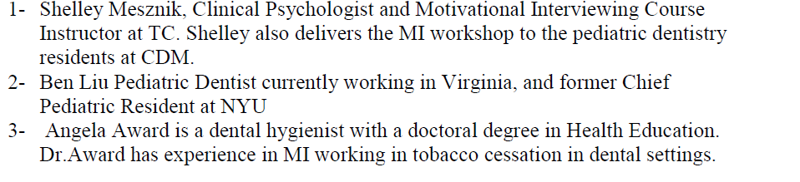
For CV Studies to Work, Qualified Judges are a must!
Selecting judges with the requisite qualifications in MI (Hosam Alrqiq, 2017)

Slide 14
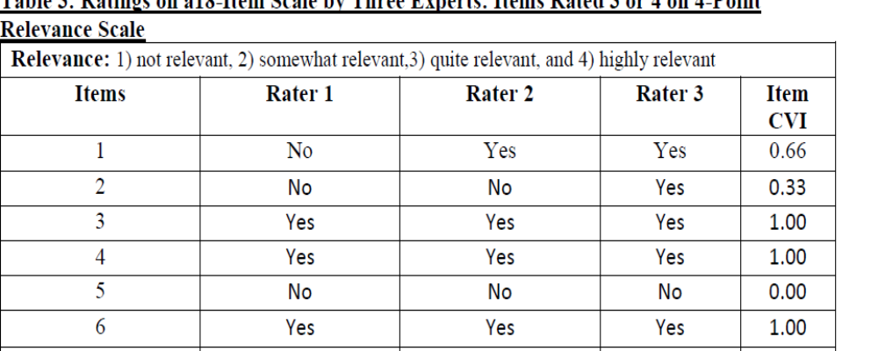
I. Content Validation Survey-Results (Hosam Alrqiq, 2017)

Slide 15
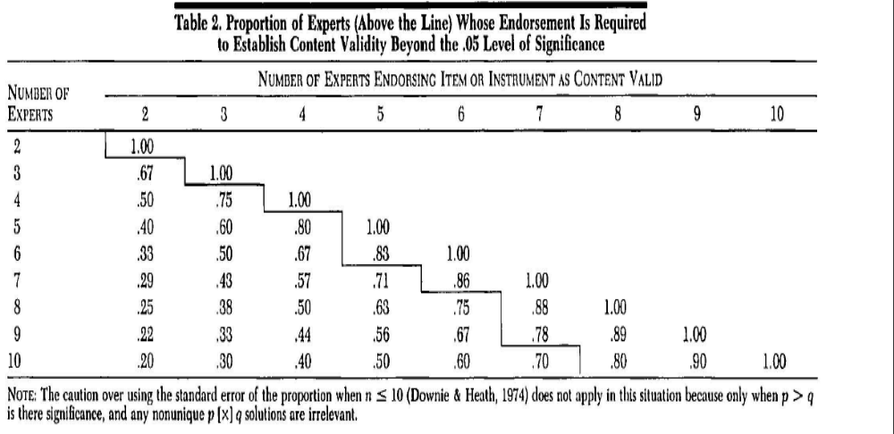
I.CVI-Criteria for Interpretation (Lynn, 1986)—CVI indices above the line are significant at .05 alpha level

Slide 16
Computing Levels of Expert Rater Agreement with Cohen’s Kappa (2 raters—symmetric tables)
Ratings from Rater B | Ratings from Rater A
 |  | Satisfactory | Unsatisfactory
 | Satisfactory | a (11) | b (4) | a + b
 | Unsatisfactory | c (1) | d (9) | c + d
 |  | a + b | b + d | N = a + b + c+ d
N (items)= 25
P_{A} = Total Percent Agreement
= a/N + d/N = 11/25 + 9/25
= .80
K = (P_{A} – P_{C})/(1 – P_{C})
= (.80 – .50)/(1 – .50)
= .30 / .50
= .60
P_{C} = Percent Agreement Expected by Chance
= [(a + b) (a + c)/N²]+ [(b + d) (c + d)/N²]
= [(15)(12)/25²]+ [(13)(10)/25²]
= .50

Slide 17
Content validation-Qualitative data analysis
Content validation—Qualitative Procedures
Construct: “Political identity” (non-cognitive, attitudinal)
Item (draft): My mind leans towards political activism. (SA, A, U, D, SD)
Expert Feedback: Is “mind” referring to identity, beliefs or experience? If this question is asking about what the person identifies himself/herself as being, “mind” is not the best term. Misses the identity construct! Political activism is also very broad and undefined--context necessary for a situated interpretation. An example would help.
Action: Item revised, “I see myself as an activist for liberal causes” (e.g., I support equal rights for women).

Slide 18
Content validation-Qualitative data analysis
Key themes in context OR Key words in context method
Item (draft): My mind leans towards political activism. (SA, A, U, D, SD)
Is “mind” referring to identity, beliefs or experience? If this question is asking about what the person identifies himself/herself as being, “mind” is not the best term. Political activism is also very broad and undefined--context necessary for a situated interpretation. An example would help.
As the construct deals with political identity, the item does not fit as written. The wording of this item may pose a problem for persons taking the survey. Both “mind” and “political activism” are very ambiguous.
Common Theme 1: Broad or ambiguous item
Common Theme 2: Construct of personal identity missed

Slide 19
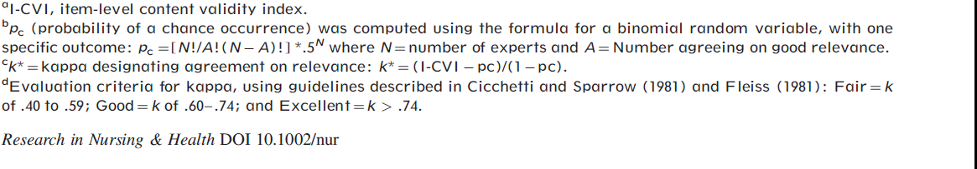
CVI calculation [Revisit Kappa* (Polit et al 2007)]
Ratings from Rater B | Ratings from Rater A
 |  | Satisfactory | Unsatisfactory
 | Satisfactory | a (11) | b (4) | a + b
 | Unsatisfactory | c (1) | d (9) | c + d
 |  | a + b | b + d | N = a + b + c+ d
N (items)= 25
CVI calculation [Revisit Kappa* (Polit et al 2007)]

Slide 20
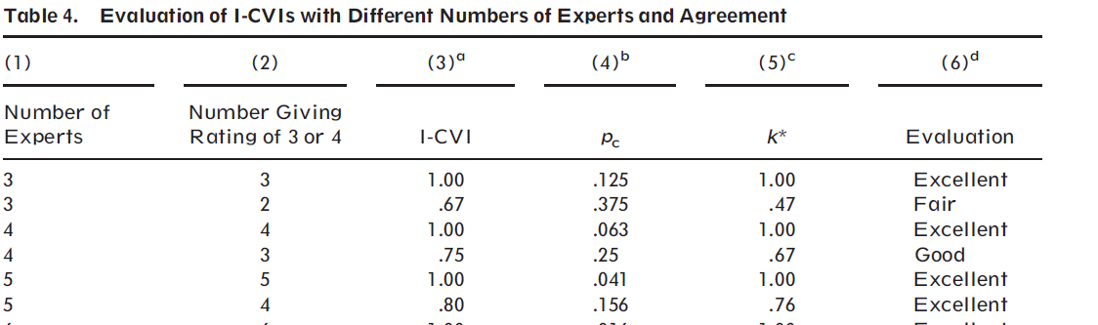
CVI calculation [Revisit Kappa* (Polit et al 2007)] contd.

Slide 21
II. Validation of Response Processes
Cognitive Interviewing with Qualitative Data Analytic Methods
  Timing? Concurrent or Post-hoc
  Small sample of Respondents: Who? How Many? 3-10
  Designing the cognitive interview
  Coding, analyzing and synthesizing qualitative data
  Taking actions
  Other methods: “In the moment” Observations, Error Analysis and Response Review, Qualitative Data Analysis Methods
  Paper Example: (Tomas Fryman, 2019)

Slide 22
Validation of Response Processes
Questions on respondents’ information processing :
  What were their mental processes as they were responding?
  How were reading and interpreting words in the items?
  Were their thinking processes and interpretations aligned with the construct? Were directions msinterpreted
Methods
  Think alouds via interviews (concurrent), qualitative data analysis
  Post-hoc interviews of how they responded to the survey items, qualitative data analysis
  Writing immediately after taking a test about reasoning or thinking processes ( e.g., Task to measure math reasoning, Q: “Are they doing it by rote use of algorithn or actual reasoning?”)

Slide 23
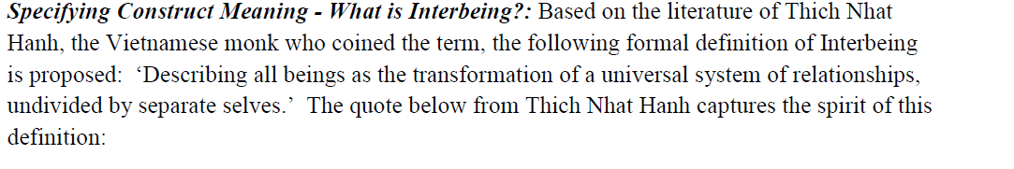
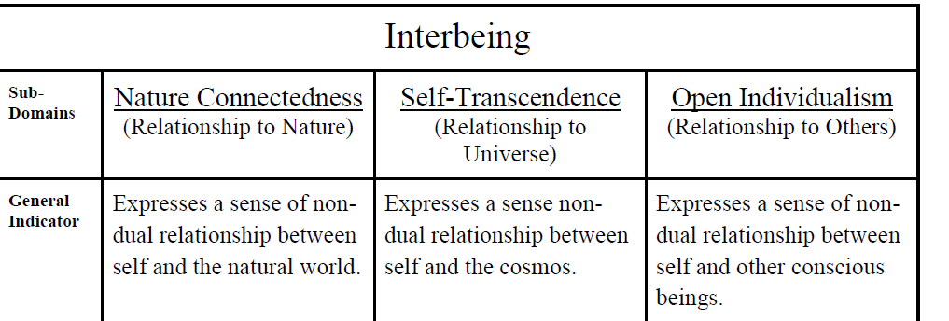
Validity of Response Processes—E.g. “Inter-being Scale” (Fryman, 2007)

Slide 24
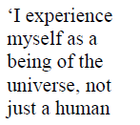
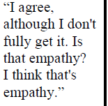
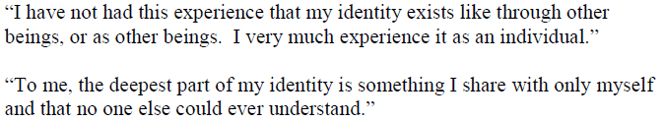
Validity of Response Processes—E.g. “Inter-being Scale” (Fryman, 2007)

